Slide 1
Progres 2 – Velocity model building & forward simulation
Azhar Harisandi - 22320011
Faculty of Mining and Petroleum Engineering
Department of Geophysical Engineering

Slide 2
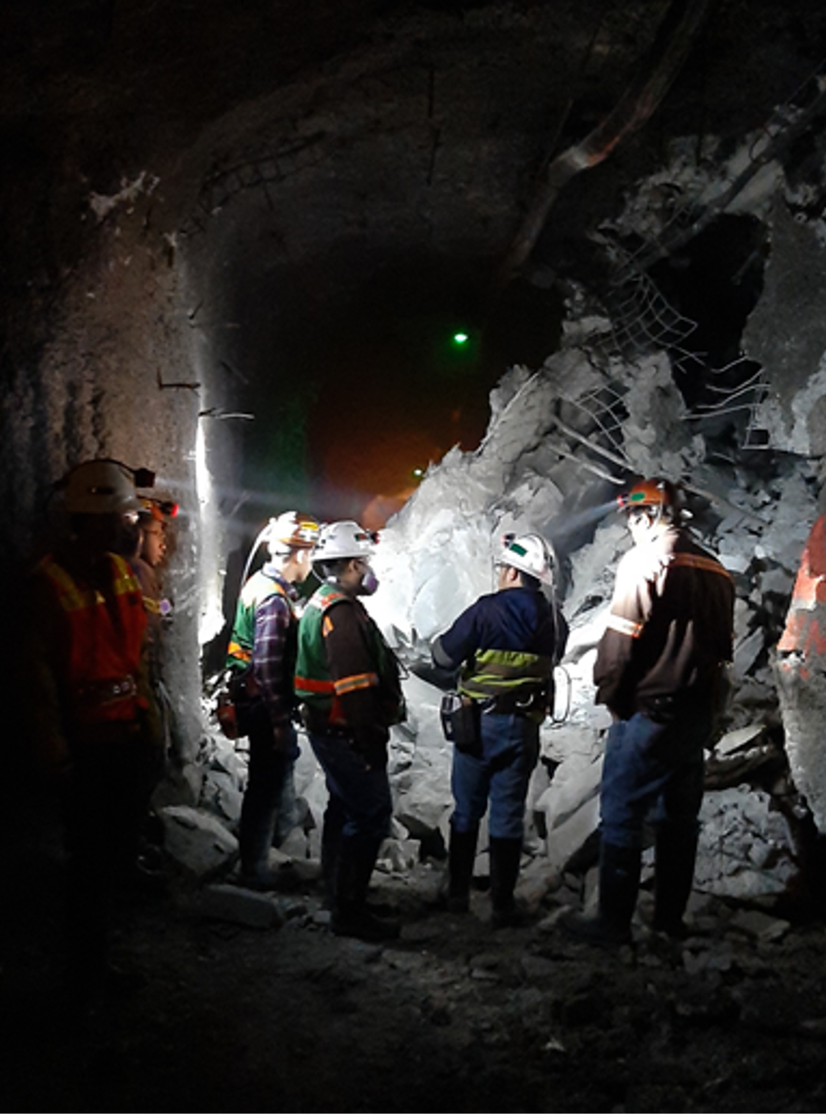

Simple Model 1

Slide 3
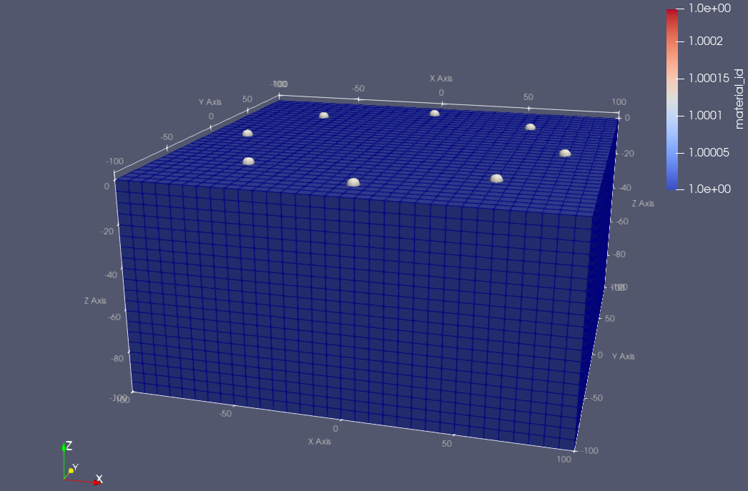
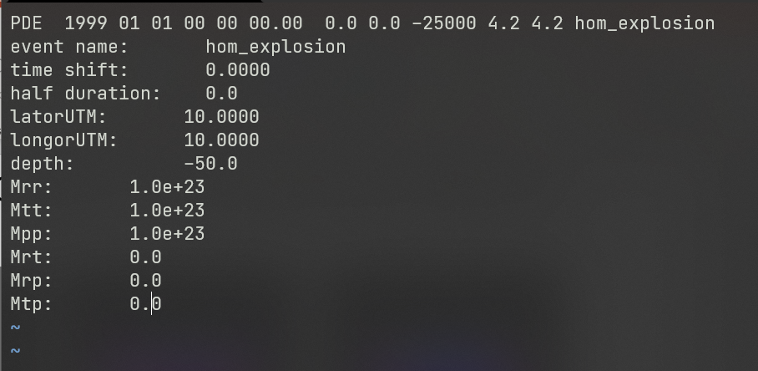
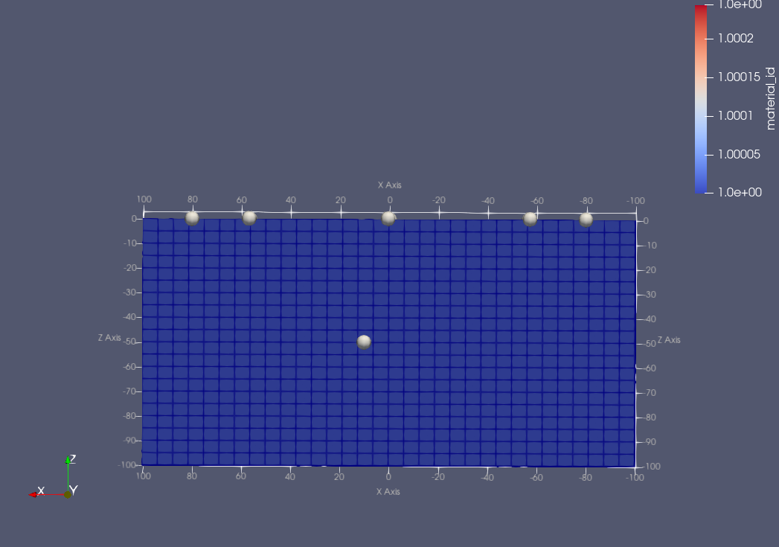
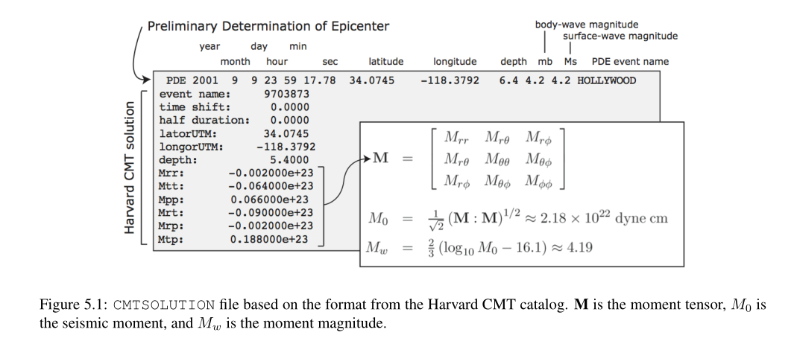
Model configuration
XMIN, XMAX = -100, 100 (in M)
YMIN, YMAX = -100, 100
ZMIN, ZMAX = -200, 0
N of elements in X direction = 32
N of elements in Y direction = 32
N of elements in Z direction = 20
Homogeneous
Vp = 2200 m/s
Vs = 1400 m/s
Density = 2200 kg/m³
Source : explosion
Source

Slide 4
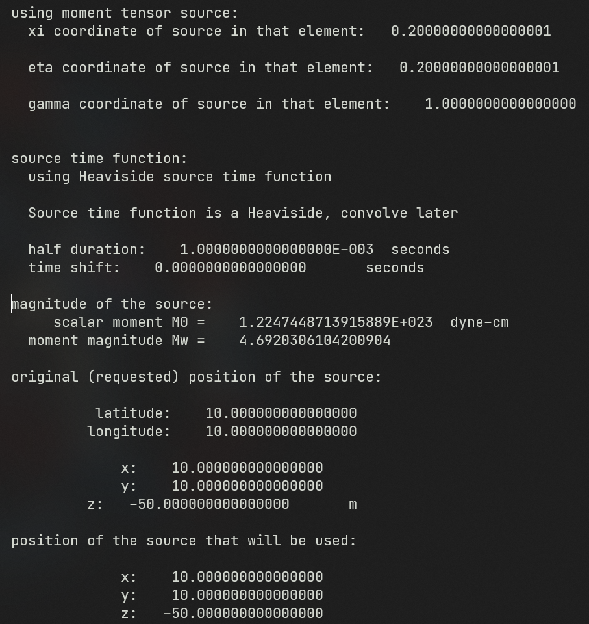
Source Magnitude and Parameter

Slide 5
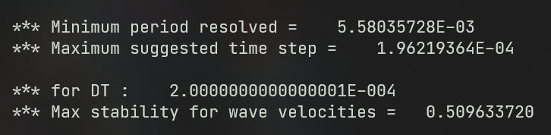
Simulation parameter to tune
DT = time step size in seconds
NITER = time iteration
HDUR = Half-duration of source time function
Suggested value for this particular mesh configuration

Slide 6
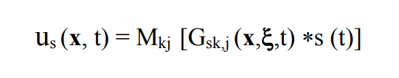
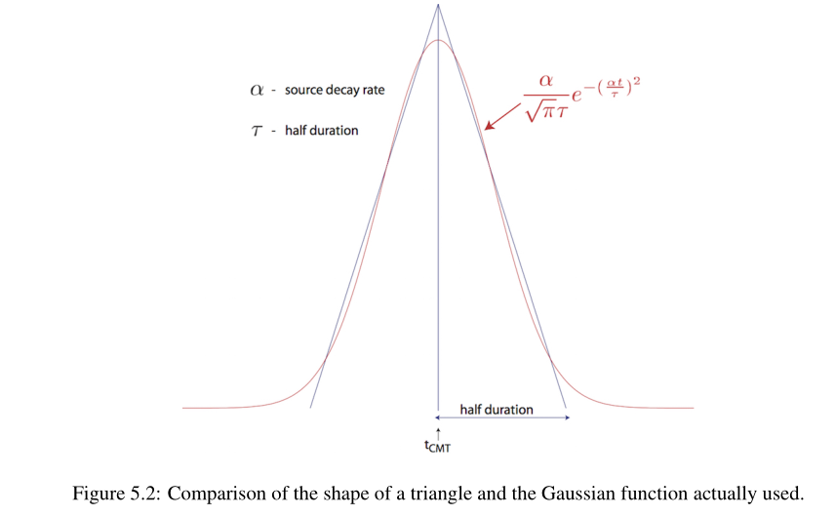
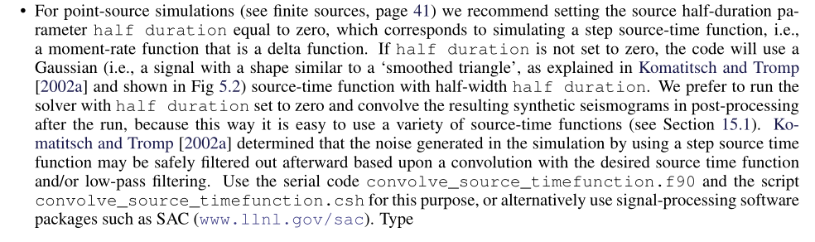
Source Parameter
Ground displacement
Green’s function (reflectivity)
Moment tensor
Source time function
From specfem3d Documentation :

Slide 7
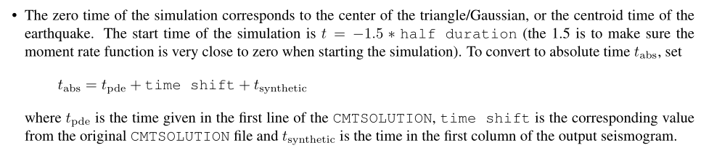
Zero time

Slide 8
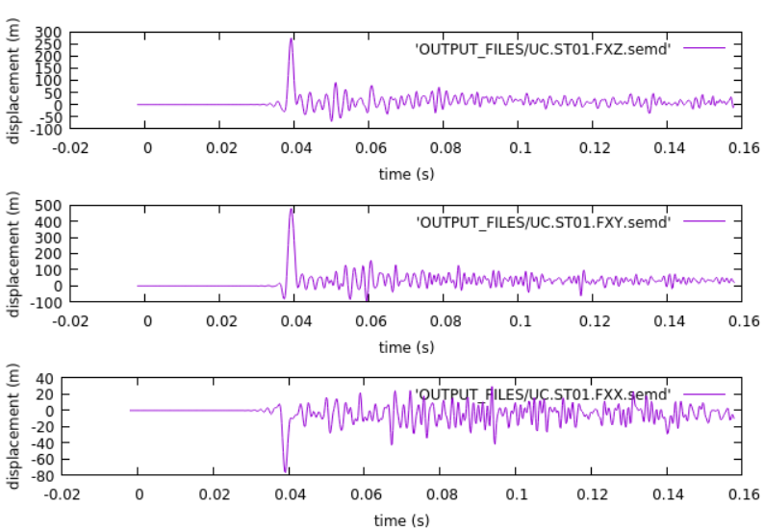
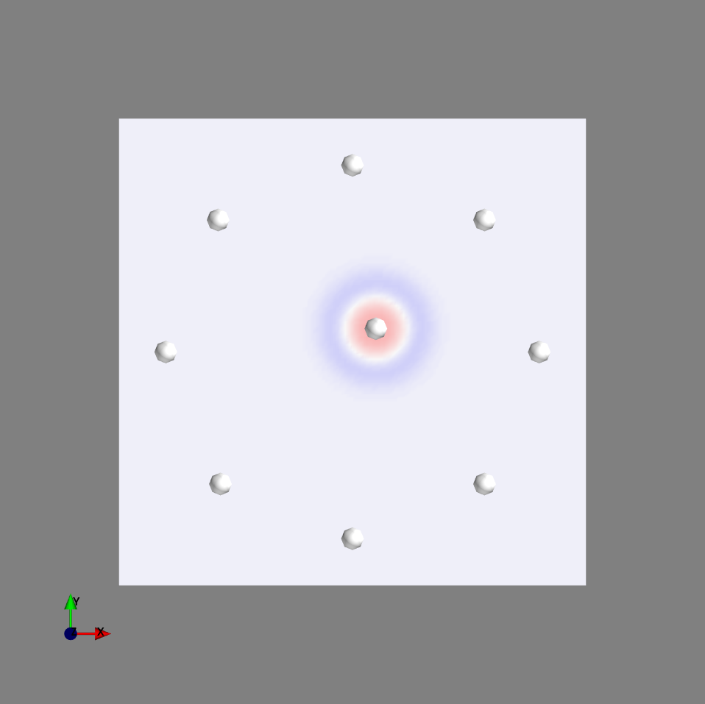
Synthetic seismogram
ST01
ST08
ST02
ST07
ST03
ST06
ST04
ST05
Half-duration = 0.0
.semd = displacement
FXZ = Z component
FXY = Y component
FXX = X component

Slide 9
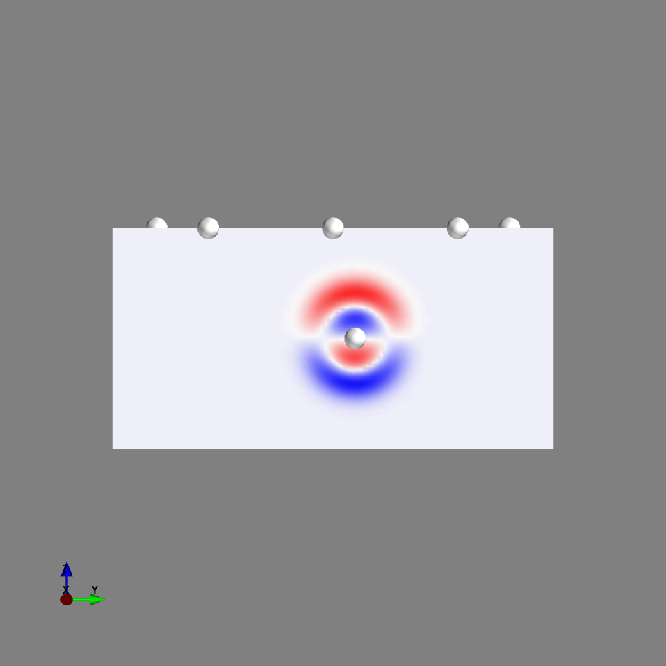
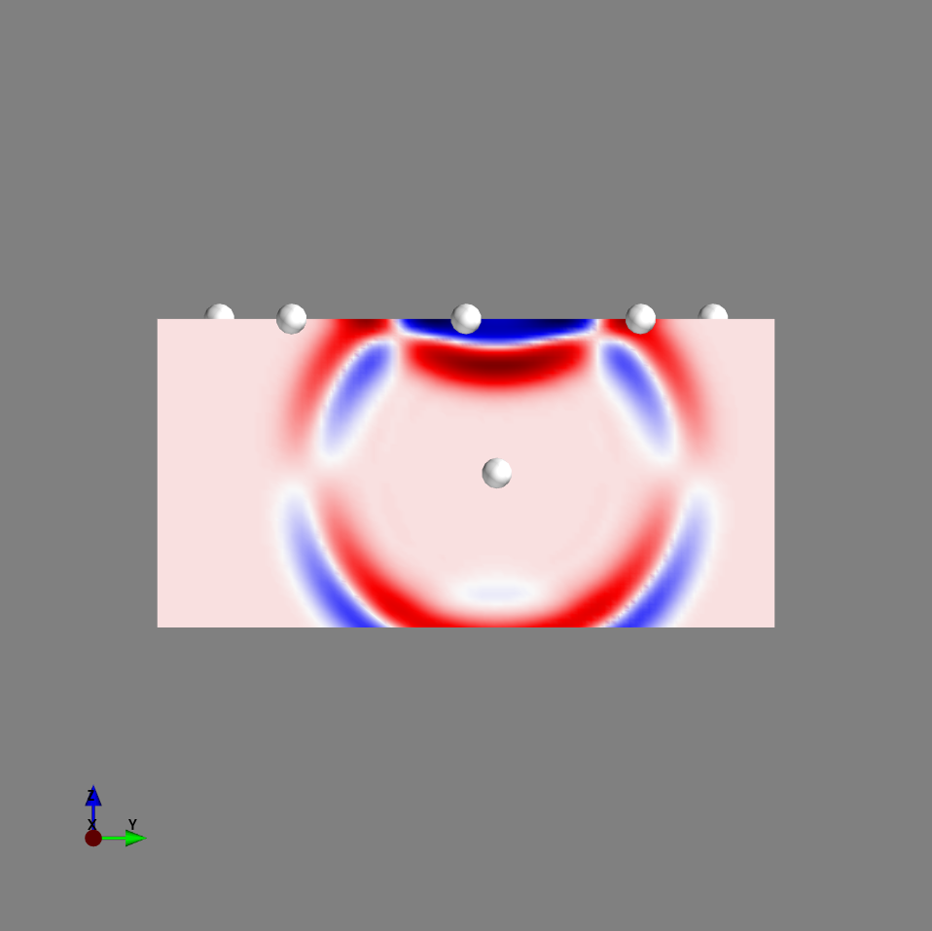
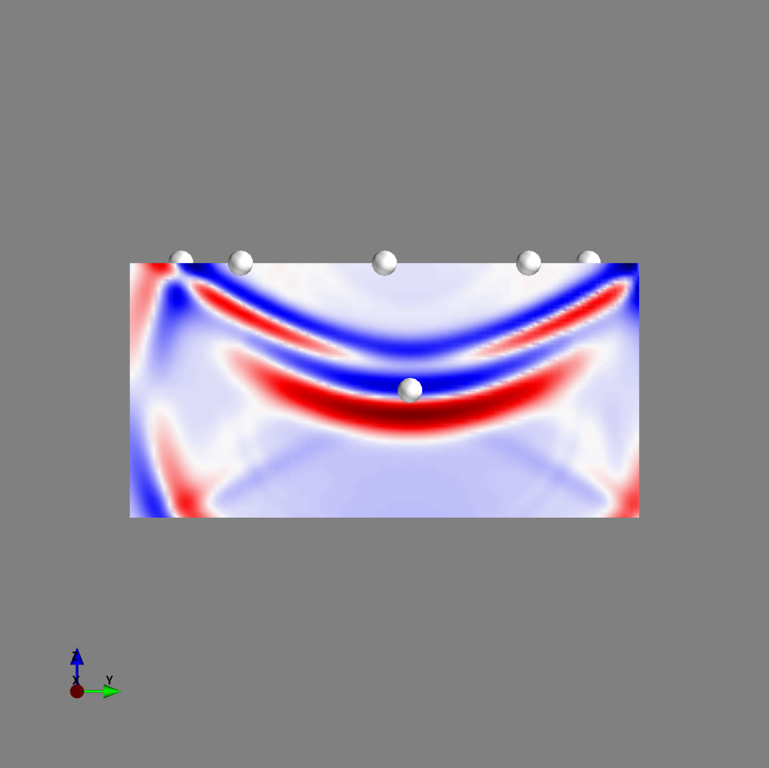
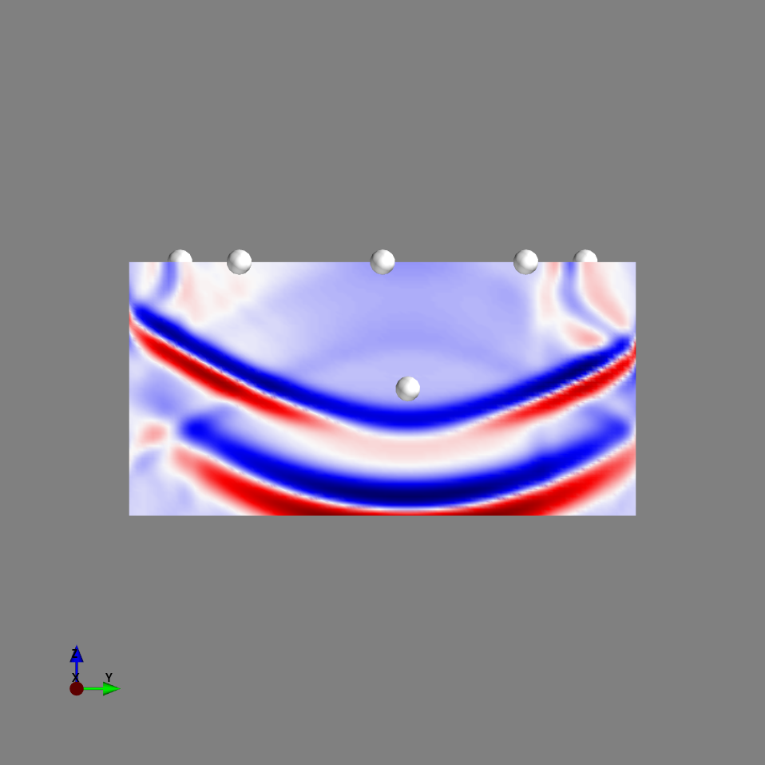
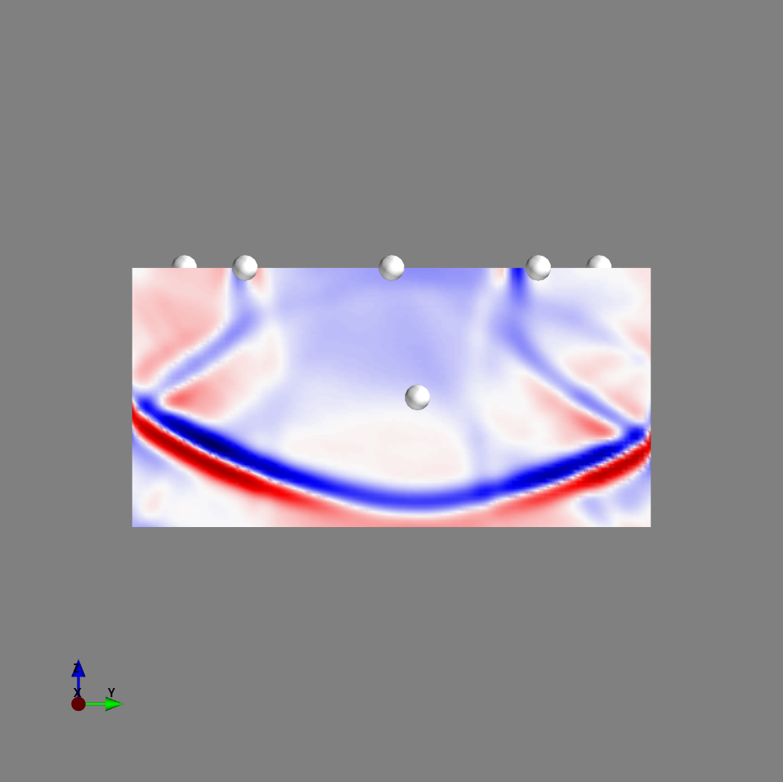
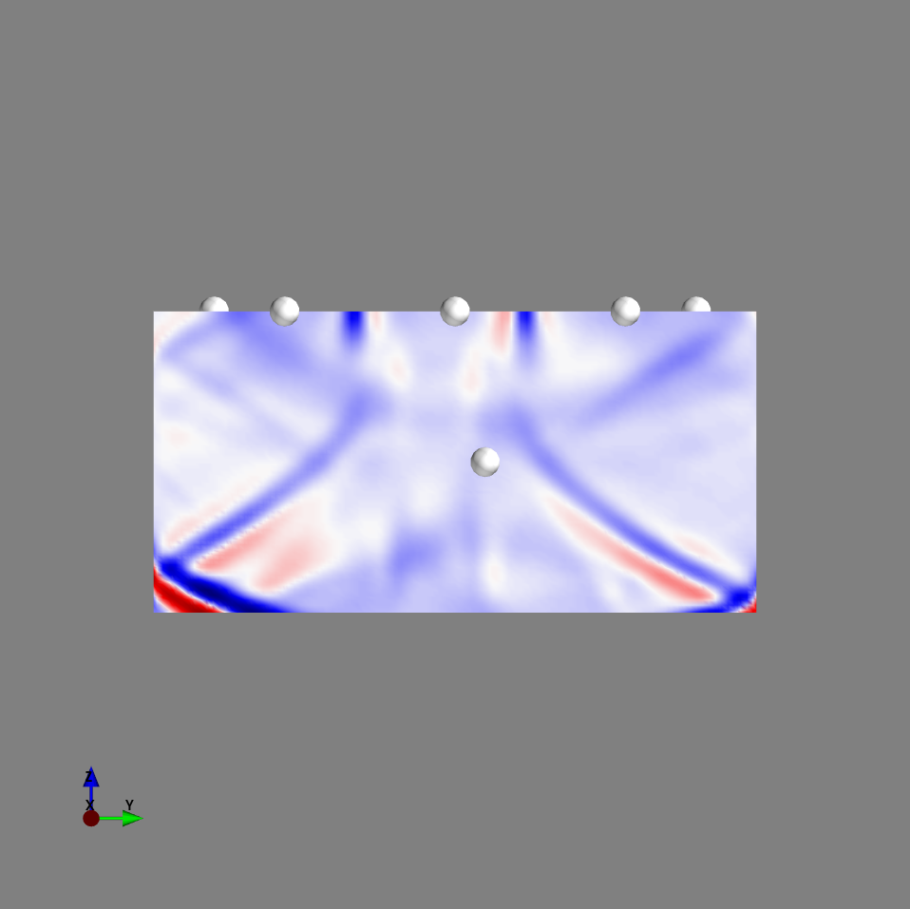
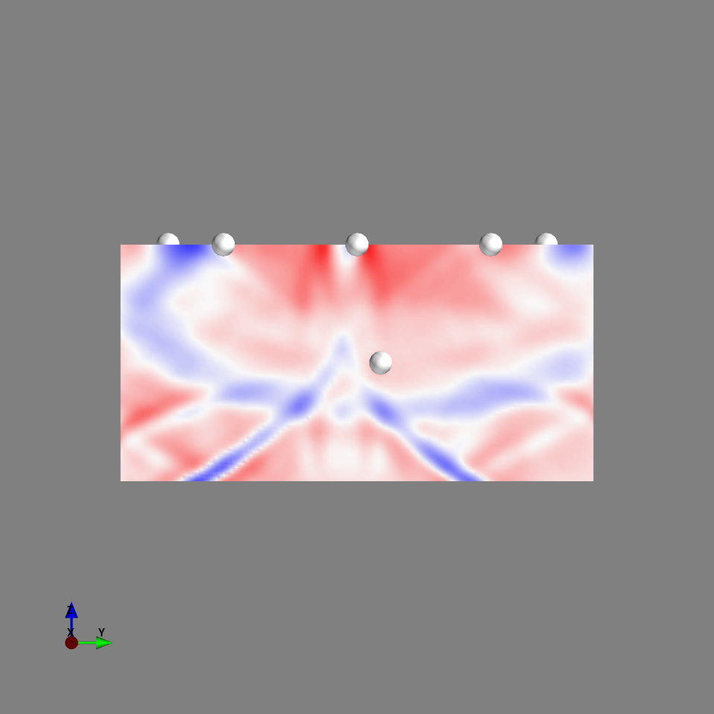
Movie volume (velocity Z component) slice at y=10 (+=red)
iteration100
iteration200
iteration300
iteration400
Reflected from free surface
iteration500
iteration600
iteration700

Slide 10
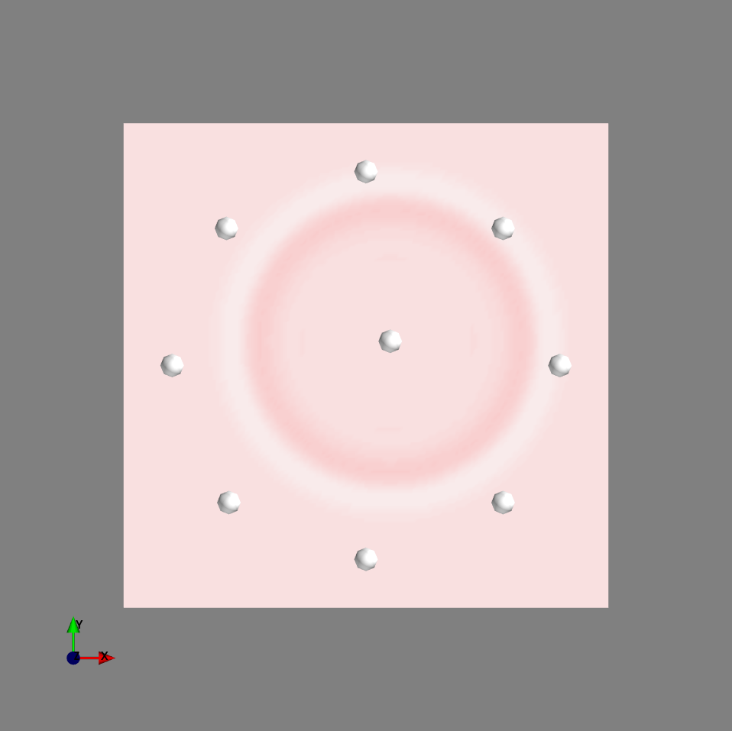
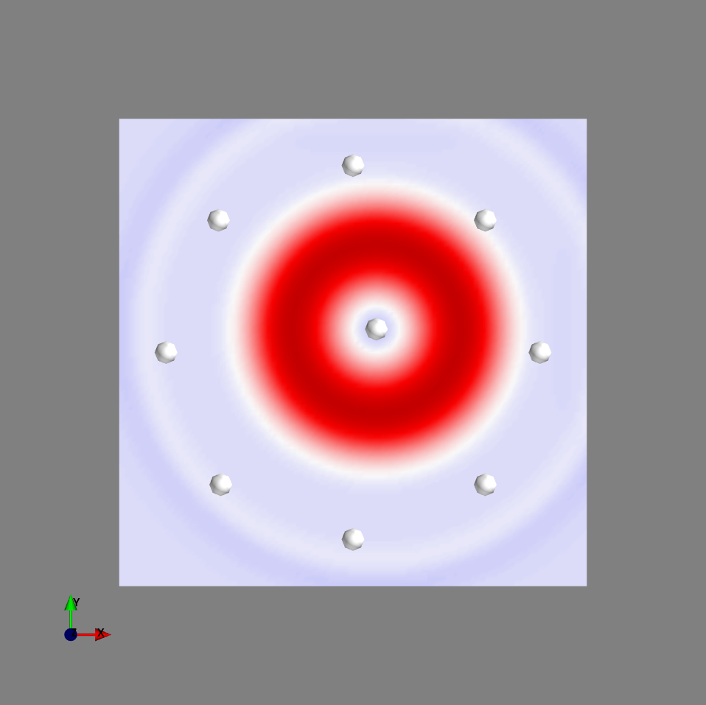
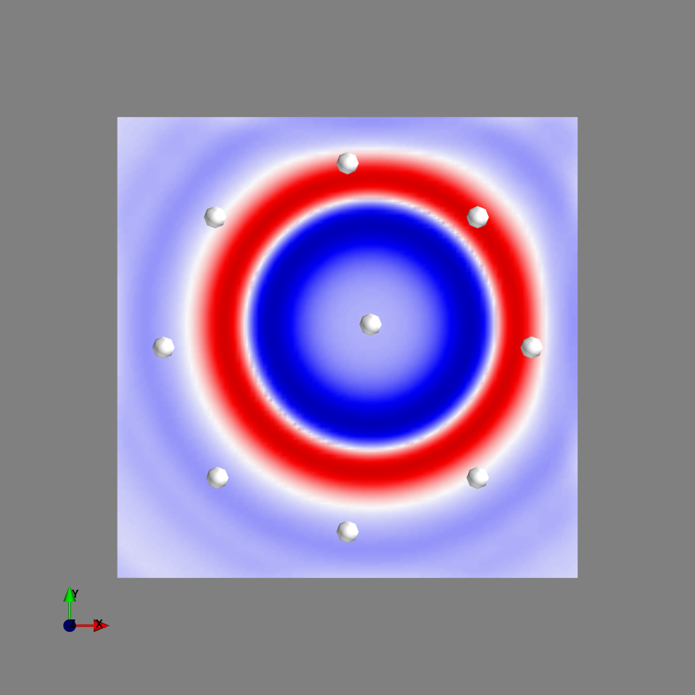
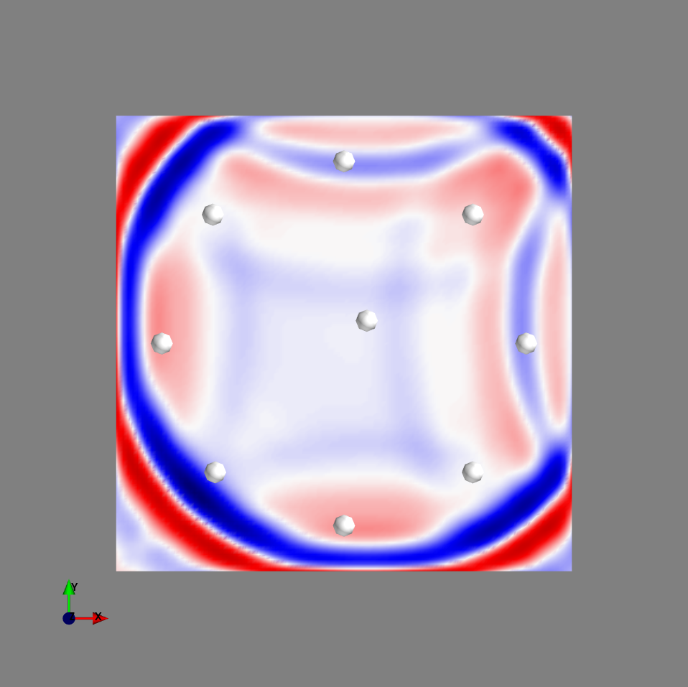
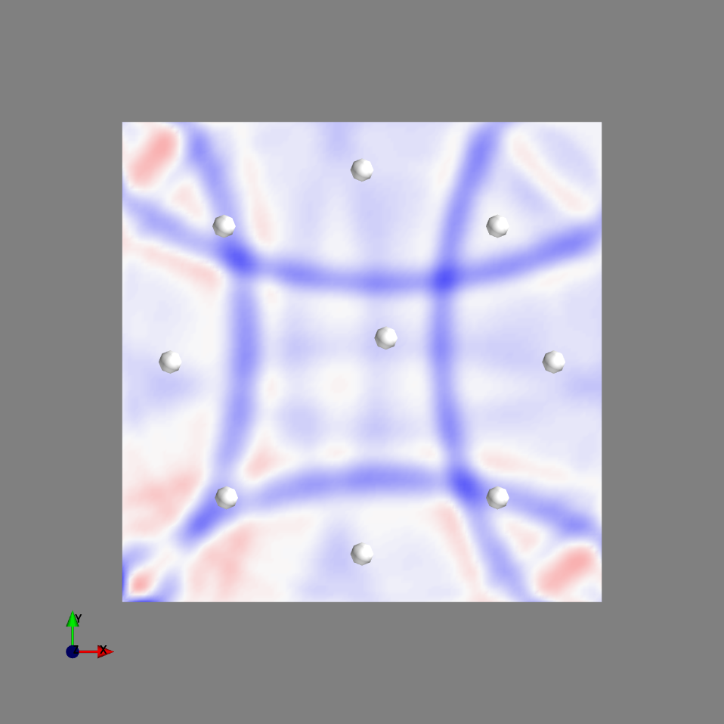
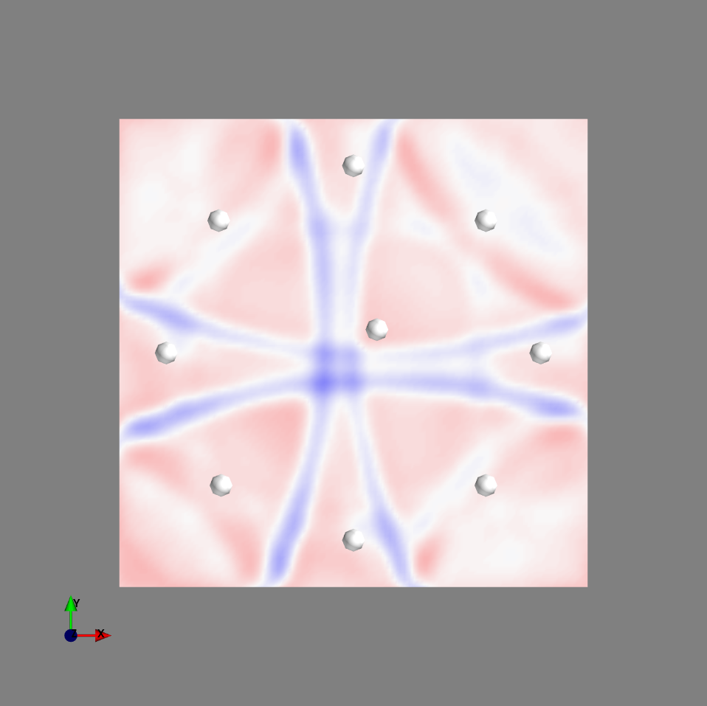
Movie volume (velocity Z comp.) slice at z = -50
iteration100
iteration200
iteration300
iteration400
iteration500
iteration600
iteration700

Slide 11
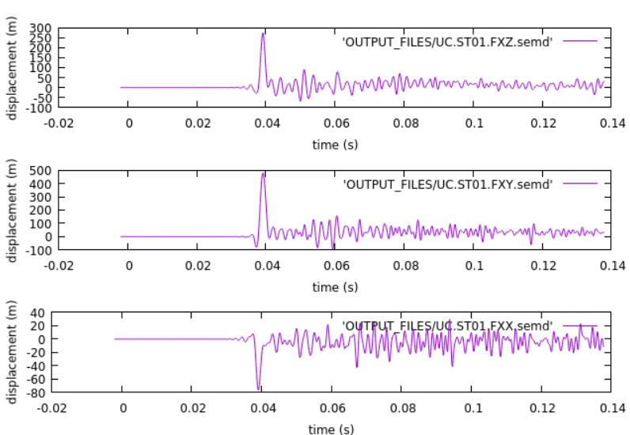
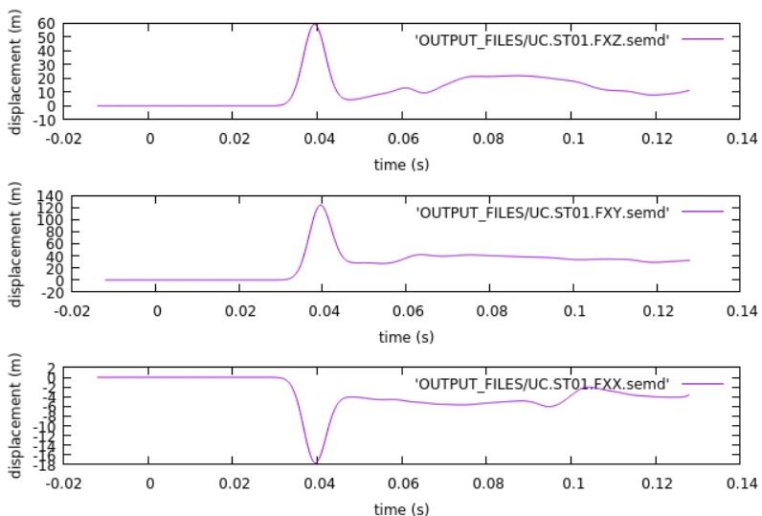
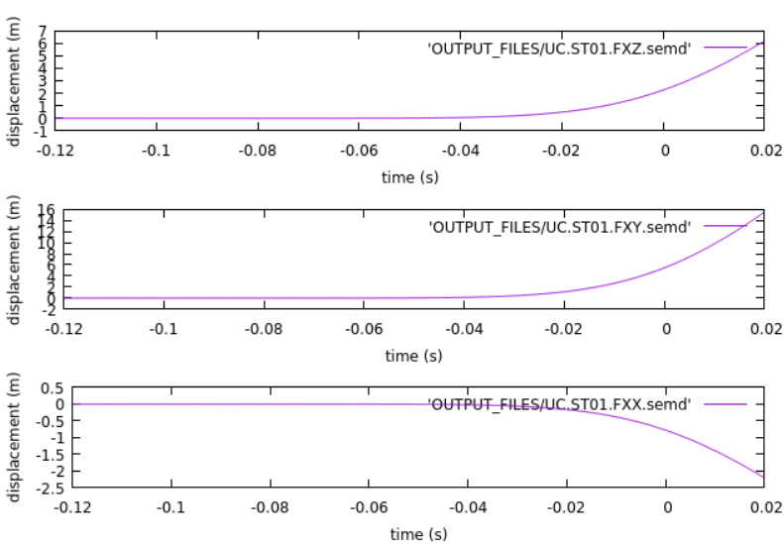
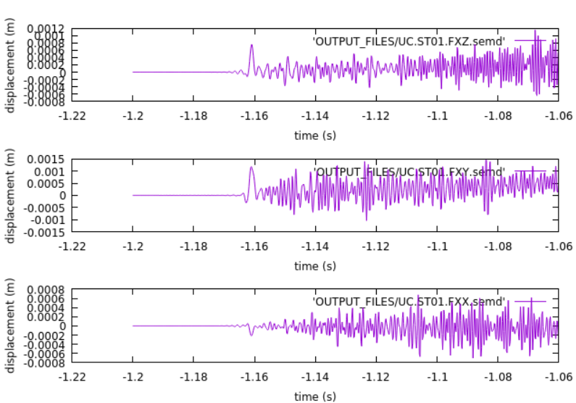
Effect of Half-duration
HDUR = 0.0 s
HDUR = 0.0001 s
HDUR = 0.006 s
HDUR = 0.06 s
HDUR = 0.6 s

Slide 12
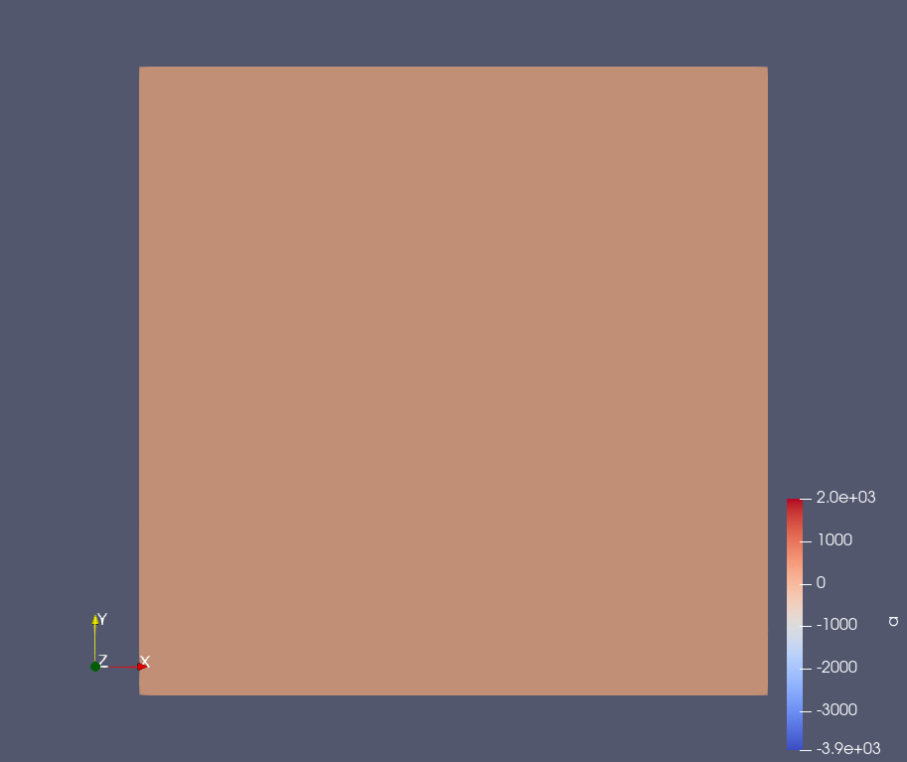
Surface Movie ( Velocity Z component at z=0)

Slide 13
Simple Model 2

Slide 14
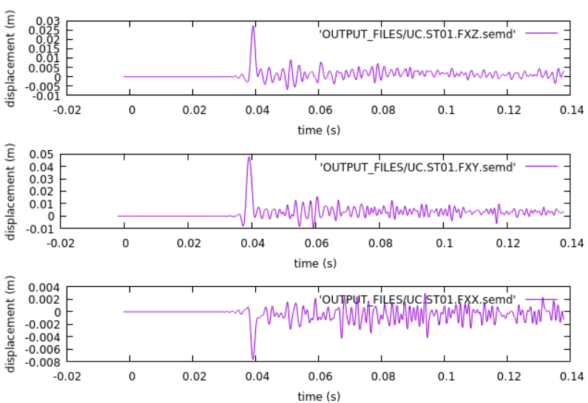
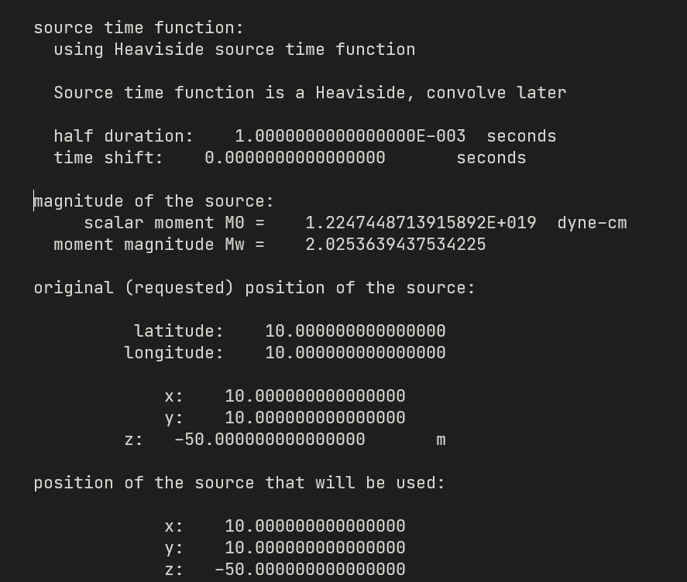
Simple model 2
Same as simple model 1, but Mw ~ 2
From simple model 1 (HDUR = 0.0, Mw~4)
From simple model 1 (HDUR = 0.0, Mw~2)

Slide 15
Tomographic model

Slide 16
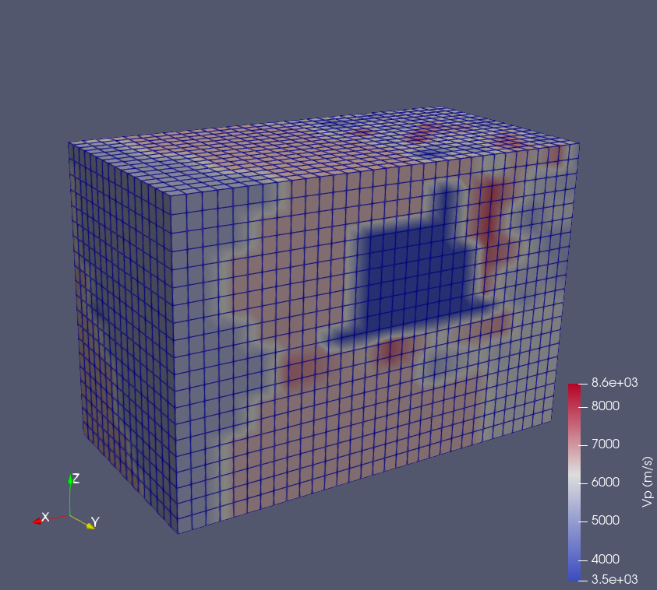
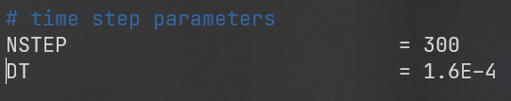
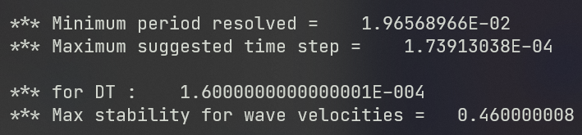
Tomographic model
We can supply tomographic model and assign vp, vs, density value to our mesh
Mesh configuration = mesh simple model
Source type = source type from simple model 2
Density calculated from Gardner’s equation

Slide 17
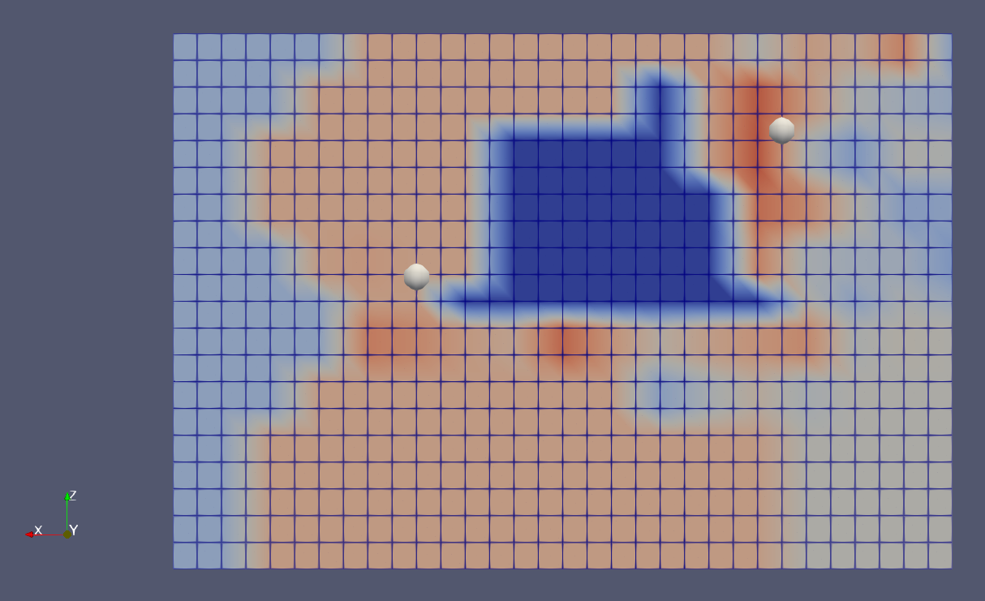
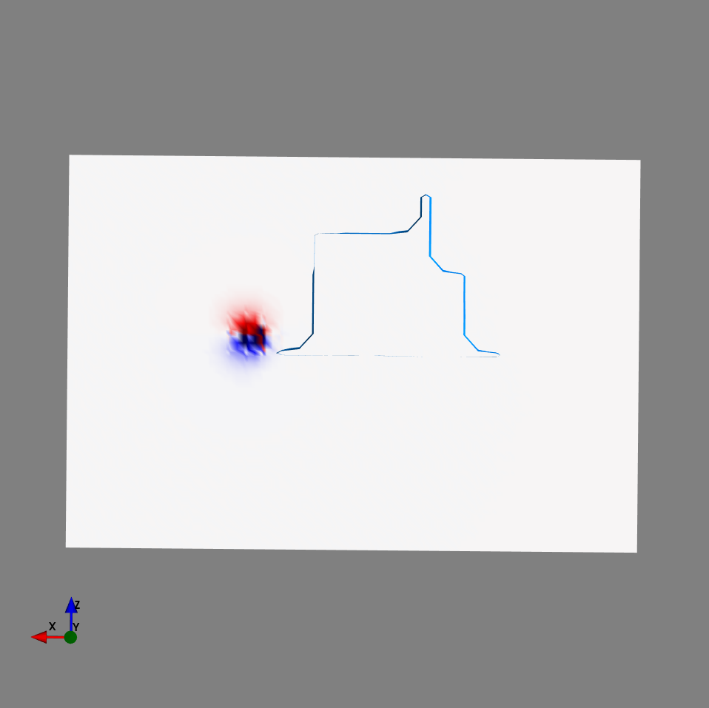
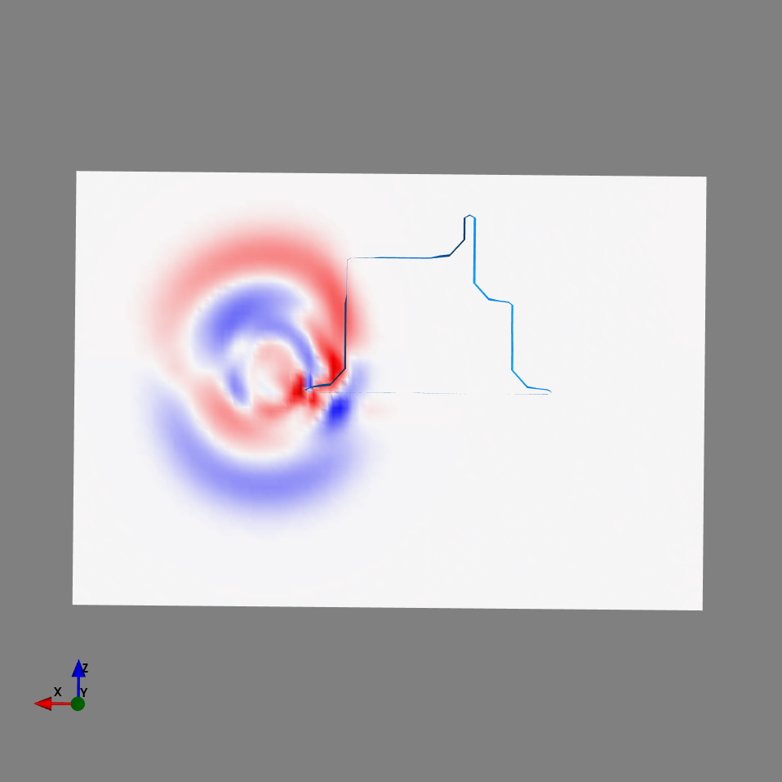
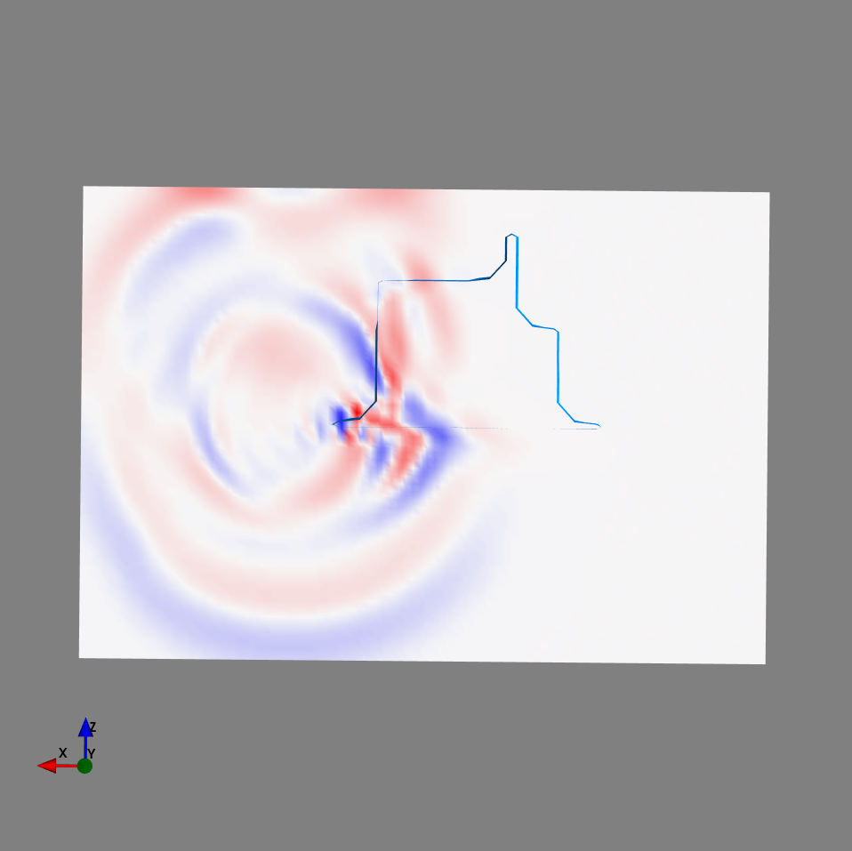
Movie
receiver
Source

Slide 18
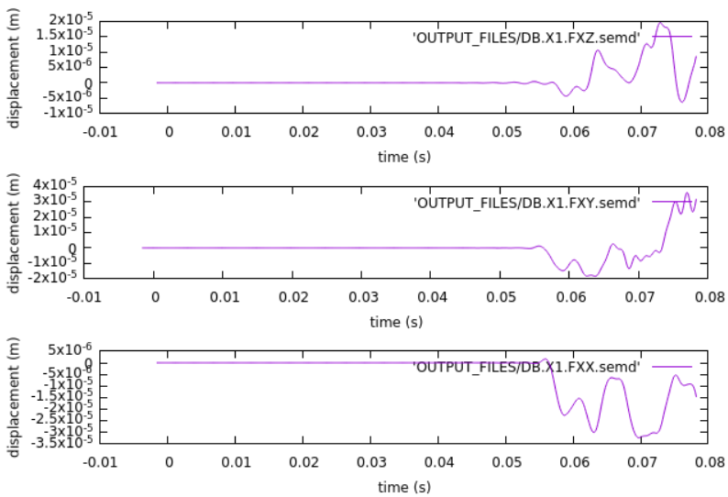
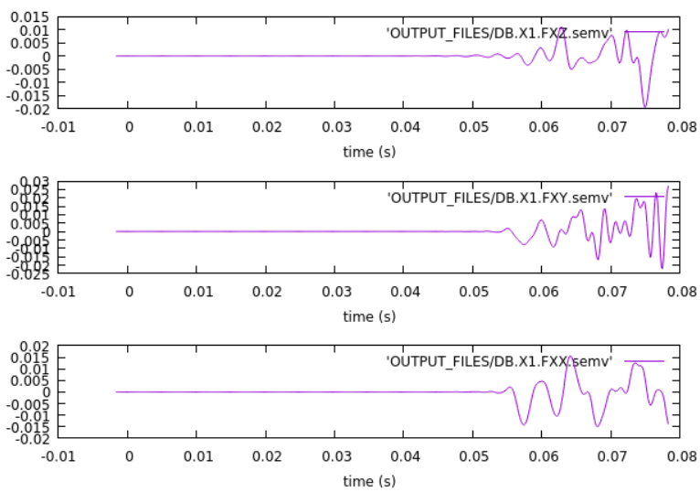
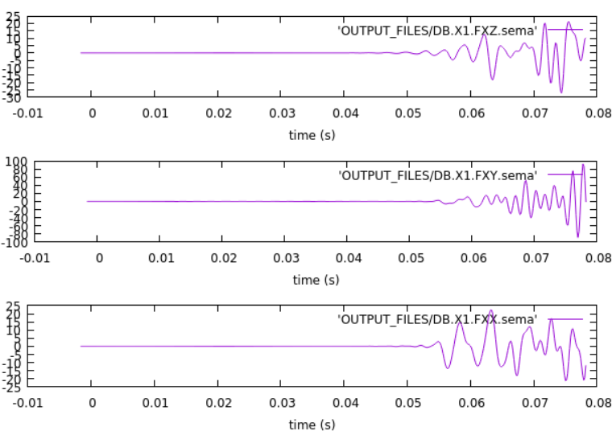
Synthetic seismogram
Displacement
Velocity
Acceleration

Slide 19
Remarks
Stacey absorbing boundary (the one that is used in the simulation) still gives significant reflection artifacts from the boundary.
PML (Perfectly-Matched layer) absorbing boundary performs better, but needs position of the mesh at the boundary (cannot be implemented with internal mesher)
Movie volume creation requires huge amount of disk space, for current configuration, each time step need about 255 MB of volume to store the wavefield (in .vtk format)
Half-duration of Source-time function can be tricky to tune for volume movie generation and surface movie generation, as the wavefield needs to be smooth enough for movie generation (not a problem if we don’t care about visualizing the movie)

Slide 20
To-Do
Try Gmsh for mesh generation to implement PML absorbing boundary
Try adjoint simulation for 1 source 1 receiver

